Slide 1

Parking Availability System
Erik Meurrens
CEN3907C – Computer Engineering Design 1
Notes:
This is the Parking Availability System also known as PAS

Slide 2

What is PAS?
A small-scale, hardware/software system providing a relatively low-cost solution for predicting parking availability within parking garages on campus.
Audience:
- Off-campus commuters and visitors
- UF Transit and Parking Services (UF TAPS) & UF Transportation Institute (UF TI)
Use-case:
Removes the stress of finding parking by letting you know if there is available parking space at a garage on campus
Notes:
PAS is a small-scale, hardware/software system providing a relatively low-cost solution for predicting availability within parking garages.
Few locations on campus have live parking counters. You don’t want to drive into a parking garage, realize there’s no parking, then fumble around on your phone, trying to find another place to park. This product will reduce the stress of finding parking on campus, and thus, our target audience is off-campus commuters and visitors, but UF TAPS and the UF transportation institute could use this system to improve parking facilities

Slide 3
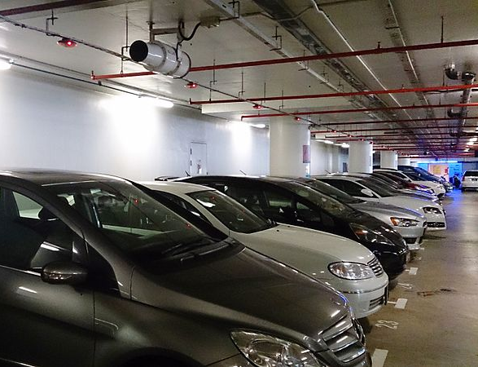
Comparable Solutions
Parking sensors
Average $300-500 per parking space
Video/image based alternatives can cost tens of thousands of dollars
Notes:
Comparable solutions include typical ultrasonic parking sensors, and video-/ image-processing based alternatives
The goal of this project is to provide a lower-cost solution than what’s available.

Slide 4
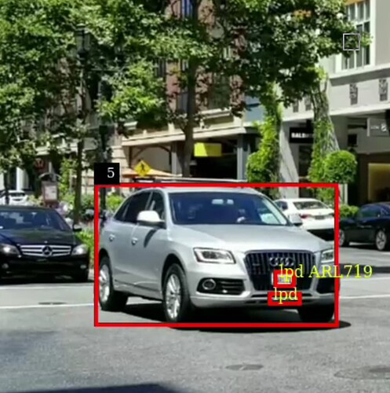
Core Features
Vehicle Detection
Inflow/Outflow, direction of vehicle
Parking Availability Counter
Potential for license plate recognition
Notes:
Core features include:
Vehicle detection
A counter for parking availability
There is also potential for license plate recognition, though this isn’t a priority

Slide 5
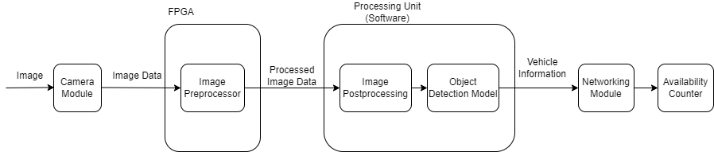
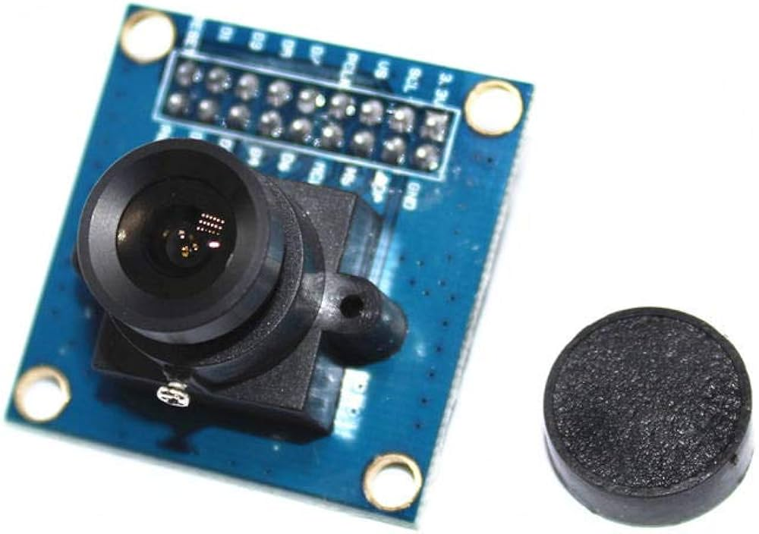

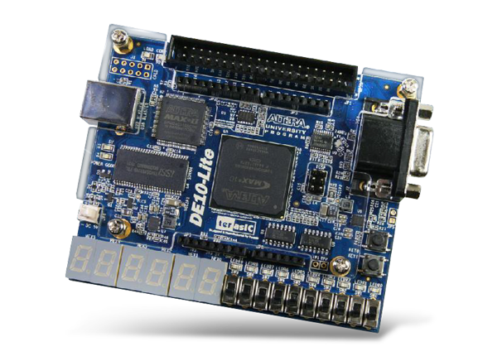
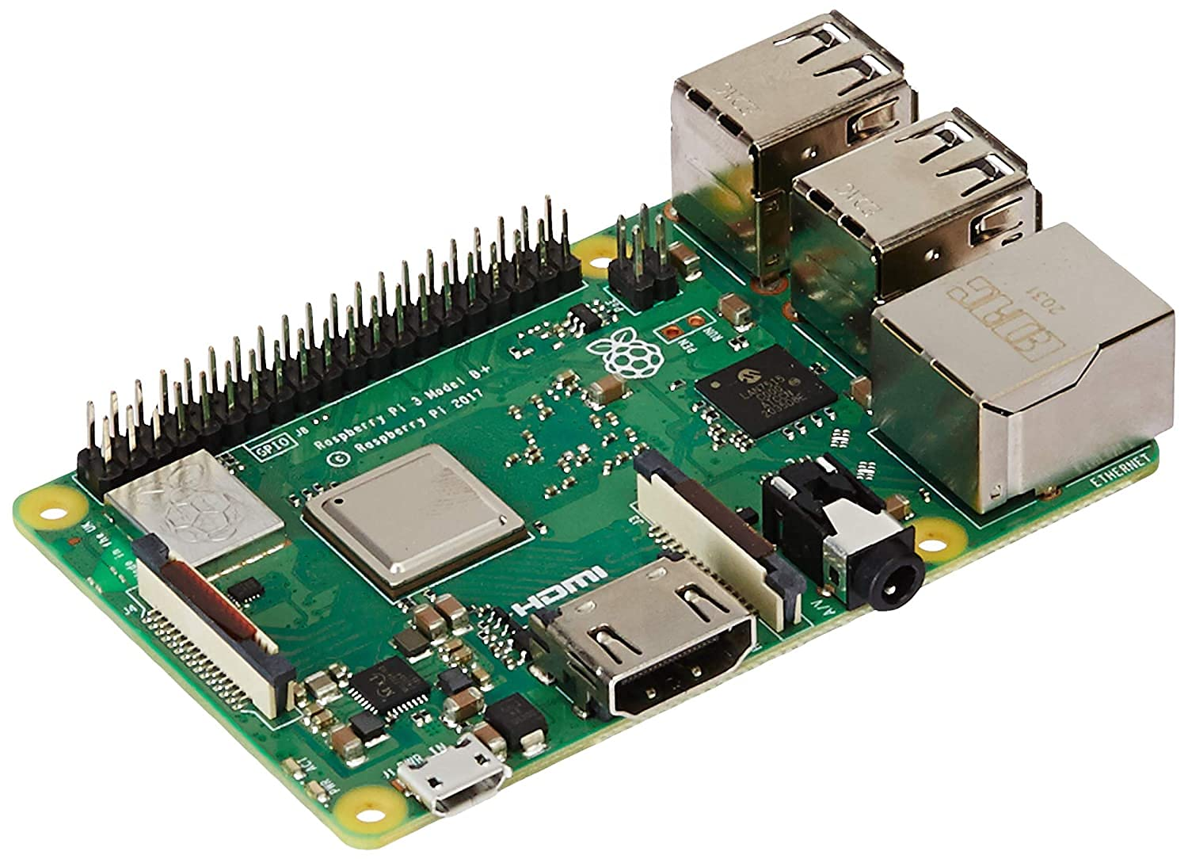
Tech Platform
71
Notes:
The tech platform consists of:
A camera module to capture image data
An FPGA to perform computationally intensive image preprocessing tasks
A processor to run post-processing tasks and vehicle detection
Some form of networking to communicate with a remote parking availability counter

Slide 6
In Summary
The Parking Availability System (PAS) is a low-cost alternative for determining parking availability that aims to minimize the stress of finding parking on campus.
Notes:
In summary, PAS is a low-cost alternative for determining parking availability that aims to minimize the stress of finding parking on campus

